Slide 1
Regional Sales 2009-2013
Source:-https://data.world/bobmajor/sales

Slide 2
Problem Statements
We Need To Determine Sales ,Discount-offered ,Profit And Order Quantity In A Region.
We Need To Determine Sales ,Discount-offered ,Profit And Order Quantity In Different Segments With Time.
We Need To Determine Sales ,Discount-offered ,Profit And Order Quantity Growth Of Various Category And Subcategory.
We Need To Determine Sales With Time With An Reference Of An Average Indicator.
We Need To Determine The Relation Between Various Aspects (Sales ,Discount-offered ,Profit And Order Quantity ) With Respect To Customers .
We Need To Determine The Profit With Respect To Every Month Of Year.
We Need To Determine Various Order Priority Preferred By Customers .
We Need To Determine The Shipping Mode Preferred By People .
We Need To Determine Sales ,Discount-offered ,Profit And Order Quantity In Different Region-sectors.
We Require A Complete Overview For All The Above Aspects .

Slide 3
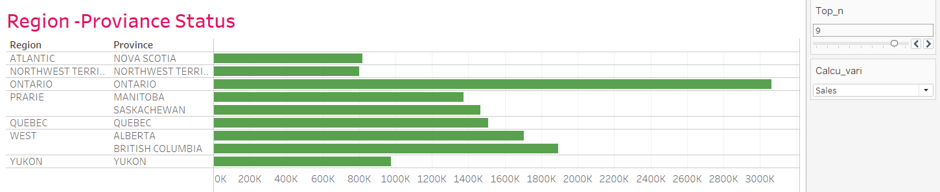
Details of a Region
This includes the region in the dataset
A brief view can be observed about sales ,discount , orders and profit in a region

Slide 4
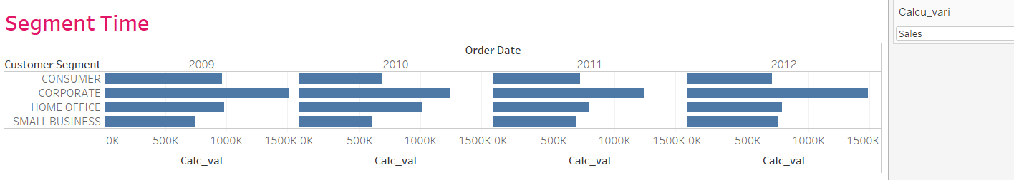
Segment with time
A brief view can be observed about sales ,discount , orders and profit in various segments .
We can analyse which segment is more profitable.

Slide 5
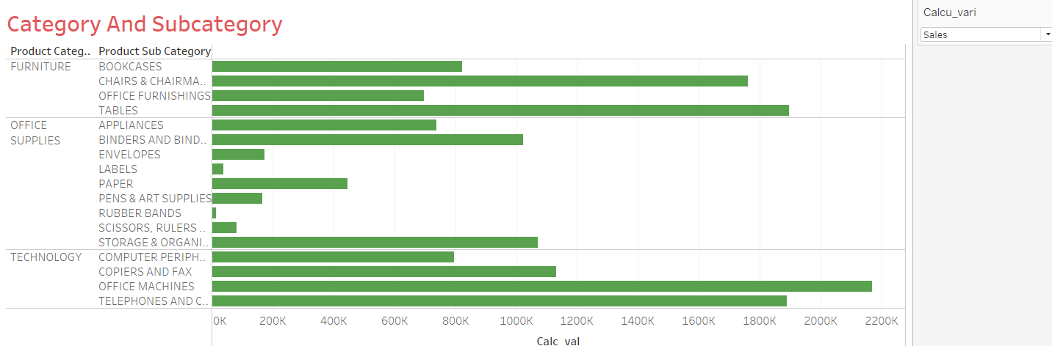
Category And Subcategory
A brief analysis can be observed of every category and subcategory
We can also filter by desired input

Slide 6
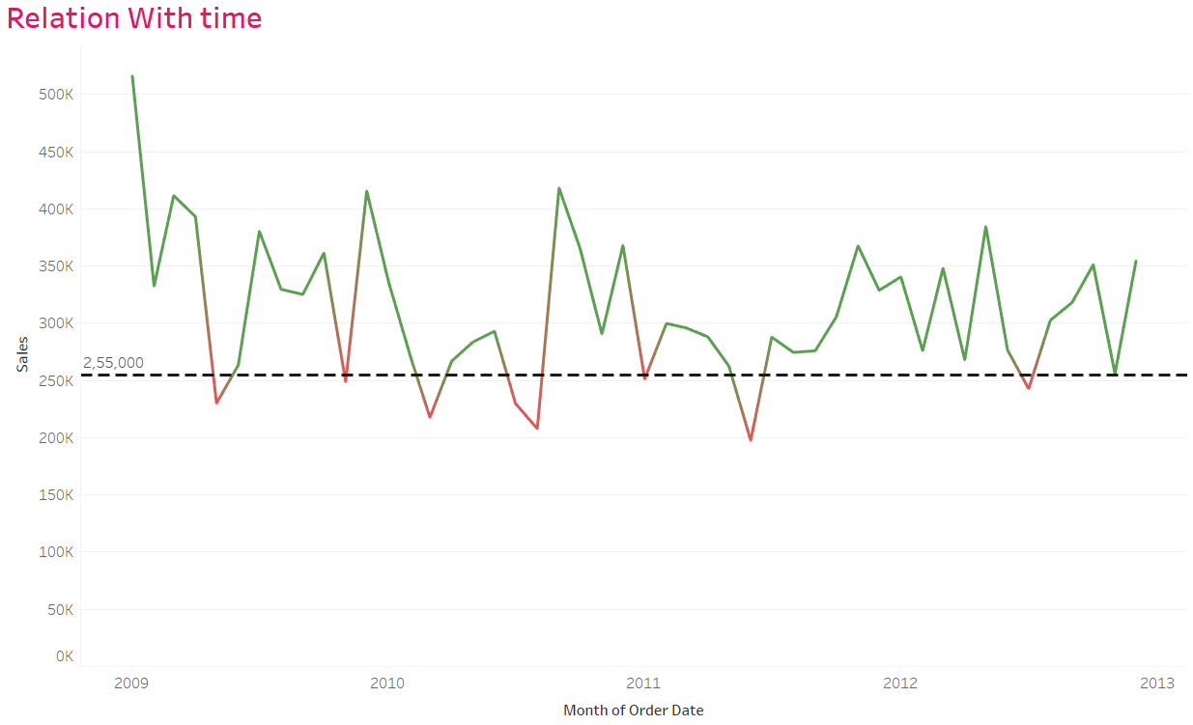
Sales With Time
Sales can be observed wit time with an average indicator
A brief view about the increment sand decrement in sales

Slide 7
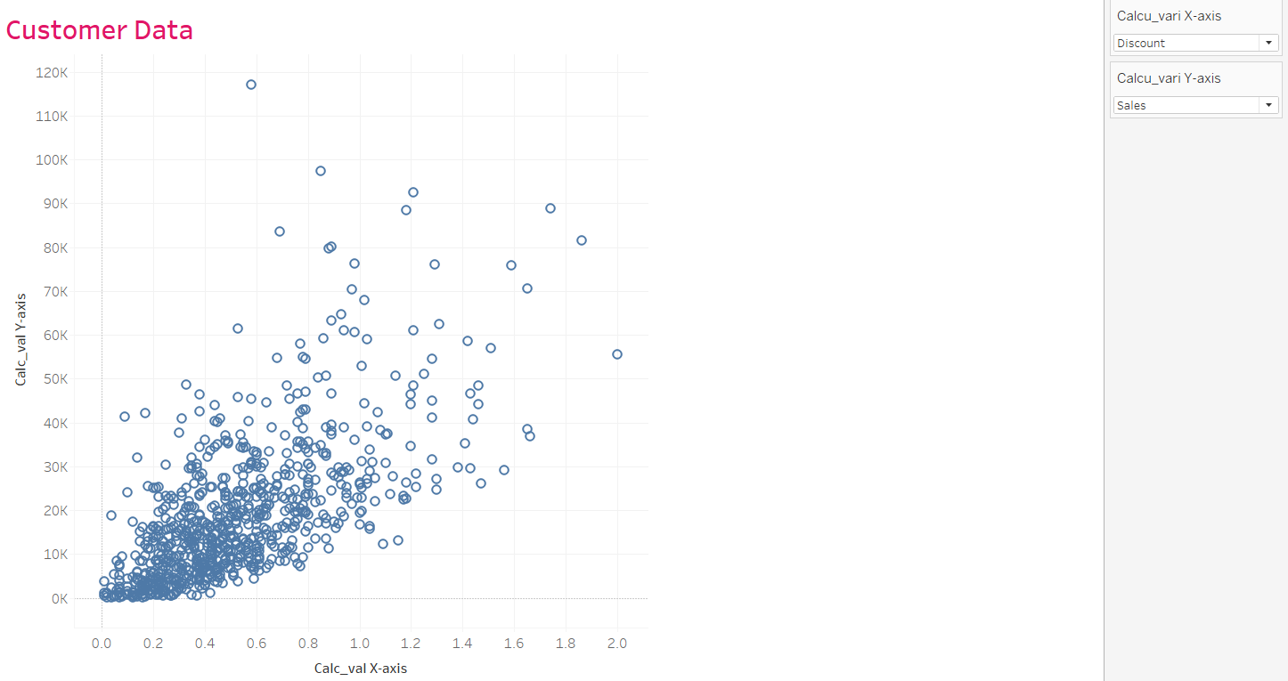
Sales ,Discount , Orders And Profit relation
We can observe a relation between various important aspect .
We can even determine the improvement on the basis of individual customers

Slide 8
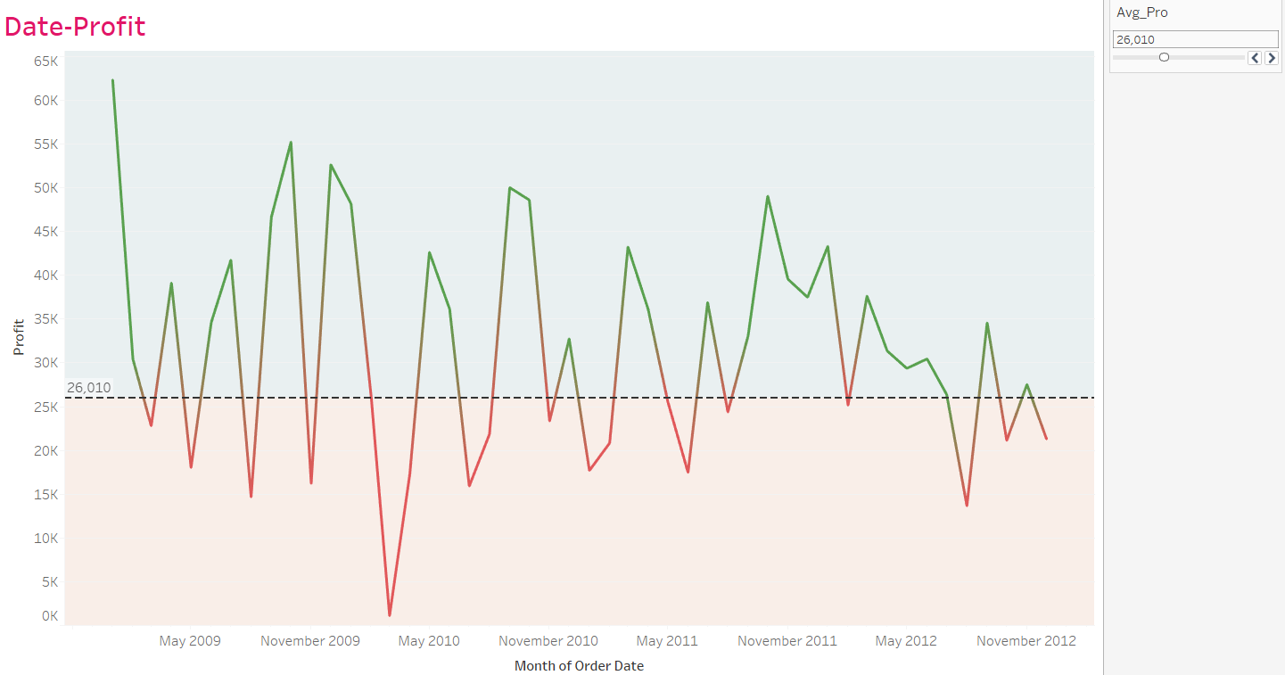
Profit-Time
We can determine the profit over time with this view
An average profit line helps to figure out the best case for us .

Slide 9
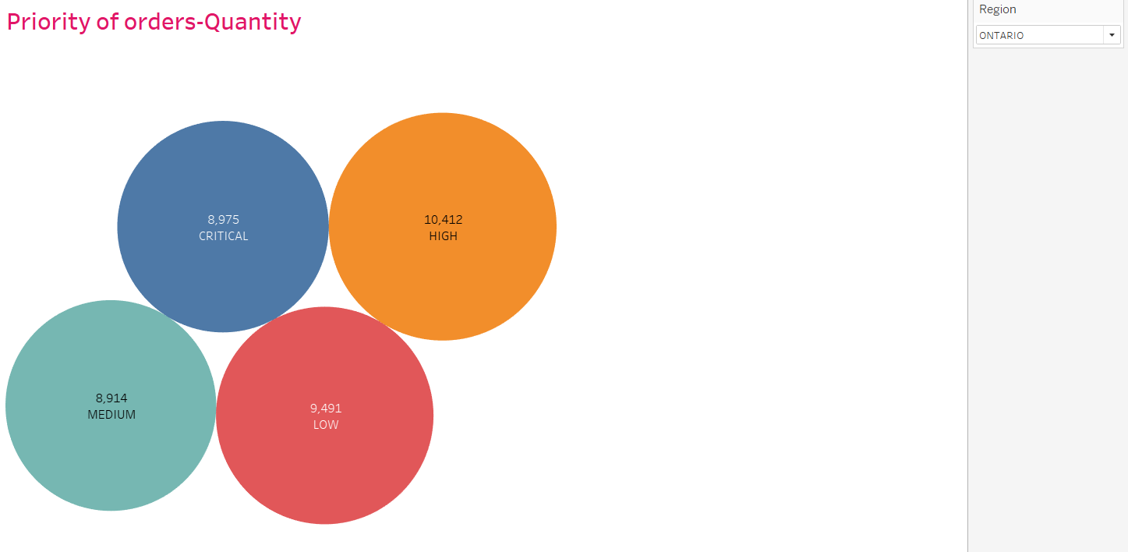
Various Order Priority
We can determine the order priority elation with sales
A brief view helps to determine the requirement of people and how it can be helpful.

Slide 10
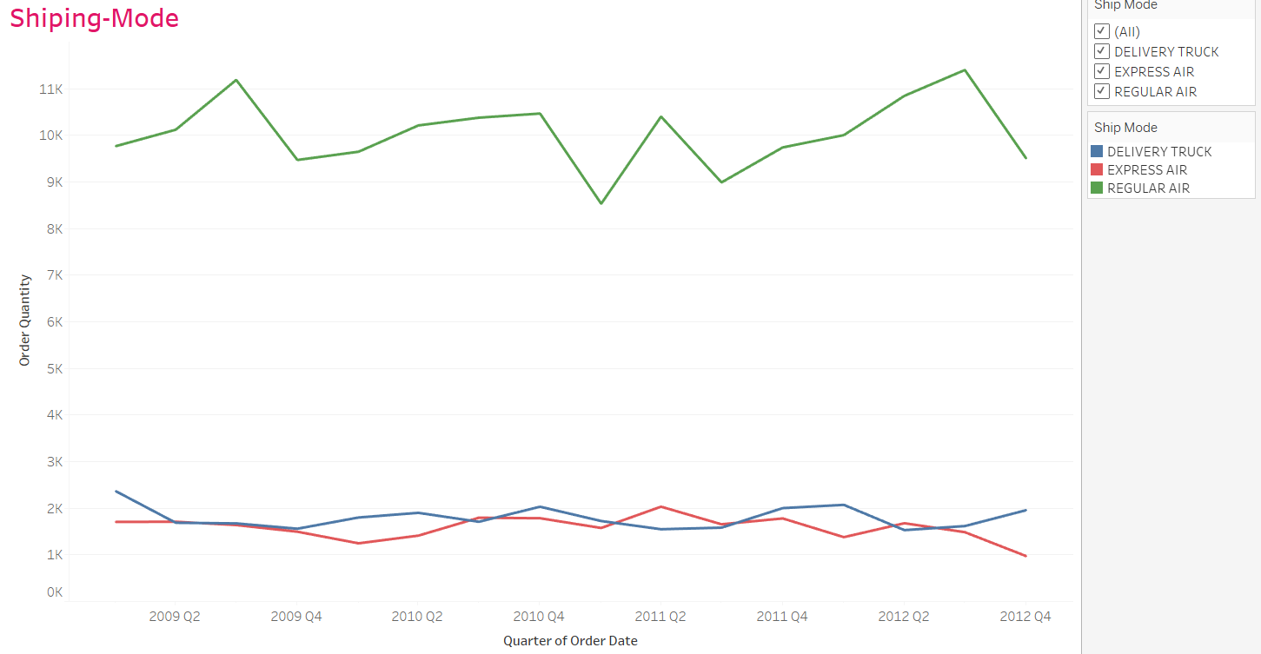
Shipping Mode
Demand of type of shipping preference helps to determine the requirement of people in a certain region

Slide 11
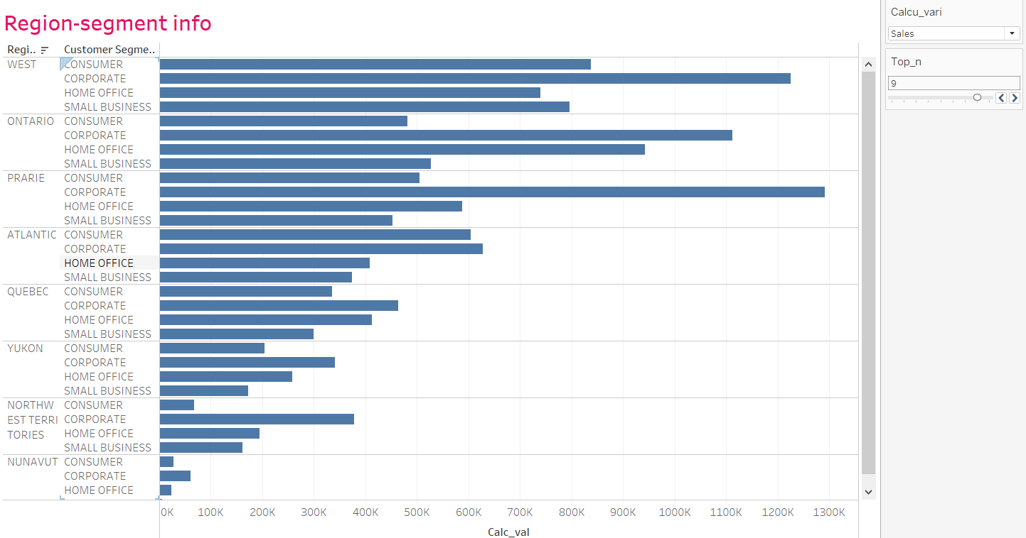
Relation Of Region With Segments
Various aspects can be determined for a specific segment in a region
We can better invest in a good profitable segment of a region

Slide 12
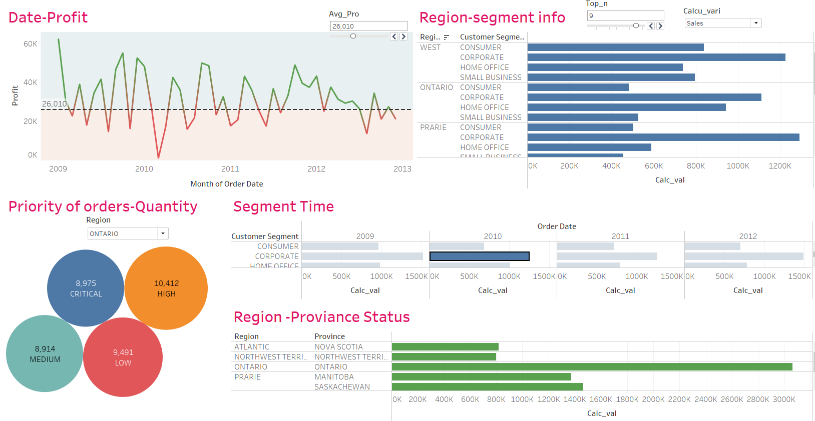
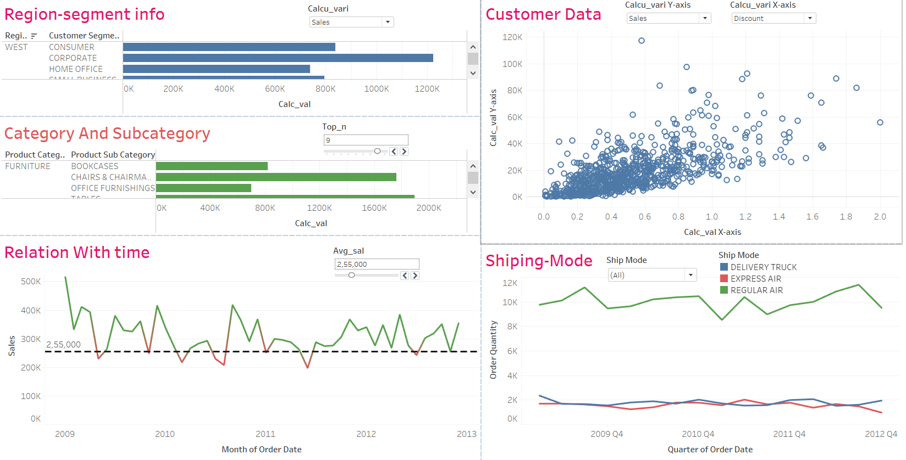
Dashboard
Overall representation of the dataset

Slide 13
Summary
We need to consider every month before invest in in a certain category.
Products which are doing good in there domain should only be stocked .
Products which are not performing good needs attention .
We can male more profit with the priority of shipping .
A better delivery services can be chosen for the best chosen for good customer experience .
Thank You

